Slide 1

Interlibrary Borrowing
Making Effective Referrals
133 Doe Library
Monday - Friday
10 am to 4 pm
510-642-7365

Slide 2
IBS Staff contact info
Elissa Mondschein 510-643-6152
Maureen Davis 510-642-7366
Duc Tran 510-642-7365
Kristen Van Vliet 510-642-2538
Department email: cuy@lib.berkeley.edu
Website, which includes links to our webforms and MYILL:
http://www.lib.berkeley.edu/using-the-libraries/interlibrary-loan-borrowing

Slide 3
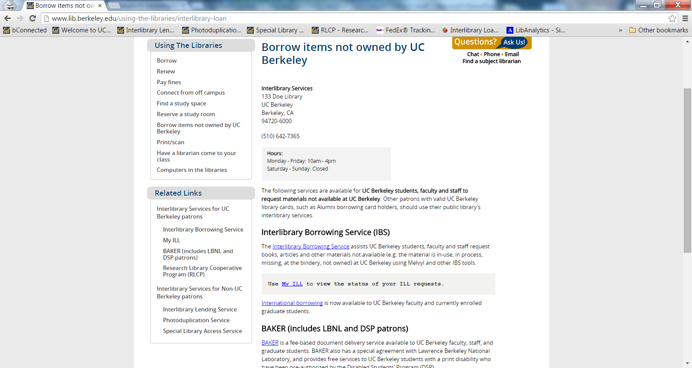

Slide 4
When to refer someone to ILS?
We don’t own it
The book is checked out
It’s on Course Reserve for a class the patron is not enrolled in
Owned by Bancroft Collections and the restrictions will not meet the patron needs.
On Search, Recall, Missing, Lost, Billed, On Order, @ Bindery, has multiple holds

Slide 5
When not to refer someone to ILS?
There is a Berkeley copy available
Films are hard to get, so if we have a copy in MRC, the patron should probably use that copy
It’s at NRLF (there are exceptions to this)
It’s part of a series and the patron hasn’t tried searching the series title.
Patron says: I NEED IT NOW!...

Slide 6
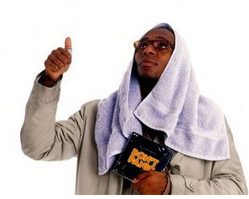
Don’t Panic!!!

Slide 7
When not to refer someone to ILS?
Cont’d.
If the patron needs it today! We try this:
  Is it owned by a library nearby that the patron can get to today? (e.g., UCB Law, Graduate Theological Union Library, a local Public Library, a local Cal State)
  Is it an e-book or an article or paper that’s freely available on the web?
Note: UCB Faculty and Graduate students can check books out directly from GTU. Other patrons can use the collection in person. They should choose this option if possible.

Slide 8
Who is eligible?
UCB Faculty, currently enrolled students and staff
UCB Retired Staff (they must get at card at the Privileges Desk)
UCB Retired Faculty
Proxy Card holders (electronic ordering not available)
Faculty, current and retired, from other UC’S
UC Extension Faculty

Slide 9
Who is eligible, cont’d.?
Visiting Scholars (registered with the Visiting Scholars Program) http://vspa.berkeley.edu/visiting-researcher-scholar
UC Berkeley Post-Docs
UCOP staff
Not Eligible:
Alumni, Community Card Holders, GTU patrons, Faculty Spousal Cards

Slide 10
What can we get?
Books, Whole Periodicals, Articles, Theses, Chapters, Pamphlets, Audio and Visual, Maps...
Transcripts of Oral History Interviews (Thank you Smithsonian!)
Some Special Collection Items
All languages and media types are welcome
(we have language experts in ILL and will shamelessly ask for help from you!)
If you need to examine something, we will try to get it!

Slide 11
What can’t we get?
Some Special Collection Items (linear feet in the record is sometimes a clue)
E-books
Current textbooks
Current year monographs can be difficult to obtain (but we will try)
Current issues of periodicals
Current issues of newspapers
TV shows on DVD (Nope, no Gilligan’s Island for you!)
Damaged or fragile material
Articles from current journals (but we still try)
Oral history recordings (transcripts are easier)

Slide 12
Some common restrictions
Library Use Only material is held for patron use in the Newspaper Microfilm Room.
DVDs and CDs designated as “LUO” are held for patron use in Media Resources Center.
Special Collections Use Only material is held in the Bancroft Library for patron viewing.
No copying, scan only on an overhead scanner

Slide 13
Please note
New York Public Library will not loan, but will often provide copies.
Library of Congress is ALWAYS restricted to Bancroft Use, 2 week loan , no renewals.
Library of Congress will not loan Periodicals, but will loan Newspapers on Microfilm

Slide 14
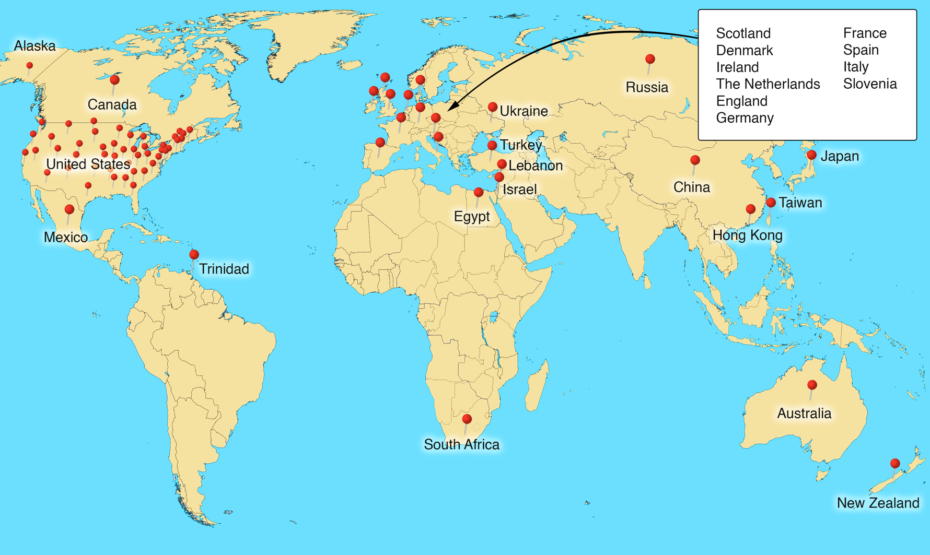
Where do we go? Everywhere!

Slide 15
Institutions we borrow from:
UC and California State University Libraries
Private and Public Academic libraries (worldwide)
Historical societies and museums
U.S. government agencies
Public Libraries (city, county, and state)
Some of these institutions are not in the OCLC system.
All reasonable lenders are in our sights. We check policies, costs, shipping, weather, lender closures and possible areas of instability.

Slide 16
Some lenders of note:
DIET Library, The National Library of the Japanese Parliament (copies only)
Library of Congress
U.S. Presidential Libraries
Smithsonian Institution
Getty Research Institute
Niedersächsischen Staats- und Universitätsbibliothek Göttingen
Center for Research Libaries
National Library of Medicine
Ethos digital theses on demand (British Library)

Slide 17
When will it come?
It depends on
whether the item is coming from a UC library or another country.
whether it’s an electronically delivered article or a rare book from the Library of Congress
If it’s at a UC campus and it’s not checked out it could come in a couple of days. If not, it can take longer.
Please keep in mind that we don’t stop until :
The patron cancels it
The need by date has passed, or
The lender list is exhausted

Slide 18
How long can I have it?
It depends …
UC’s Main library items loan for 2 months and SRLF for 6 months, renewals allowed
Non UC items loans are typically 3-4 weeks for ALL patrons, regardless of patron type
In general the lender dictates the due date and possible restrictions. 1 – 2 week due dates, especially for DVD’s can happen!

Slide 19
Renewals?
Yes! Patrons should request a renewal directly from their My ILL account.
The renewal is not instant. We will contact the lender on their behalf and then either send an e-mail with the new due date, or inform them that the lender has denied the renewal.
My ILL :
https://ucill.vdxhost.com/zportal/zengine?VDXaction=LoginPage

Slide 20
Blocks, Recalls
&
Overdues
We send two overdue emails to patrons
If the book is not returned we email a block notification, and their record is blocked in Millennium
It is the same process for recalled items except we only send one email alert before the patron is blocked

Slide 21
How can I involve others in the fun?
Can someone else place my orders for me?
Yes, if they have a proxy card. Proxy borrowers cannot order via the WEB. WE encourage people to get a proxy card if they are acting as a research assistant.
Can someone else pick up my material once it arrives?
Yes, anyone can pick up and sign for your material. They do not need your library card or any form of written permission

Slide 22
Baker Document Delivery Service
BAKER is a fee-based (deposit account) Document Delivery Service available to:
UCB faculty
UCB Staff
UCB Graduate Students
UC Office of the President staff with current UCB library cards

Slide 23
BAKER also serves the following groups by special agreement:
BAKER will provide readable, electronic PDF and Word documents of articles or book chapters to eligible Disabled Students’ Program patrons, free-of-charge. See the DSP Information for details.
Lawrence Berkeley National Laboratory staff

Slide 24
Find out more about BAKER
To find out more about BAKER, check out
the BAKER information page linked below
Read about BAKER Document Delivery

Slide 25
The RLCP Program
UCB faculty, academic staff and graduate students can borrow directly from the Stanford University Library using the Research Library Cooperative Program (RLCP). Eligible patrons may also visit Stanford and UT Austin in person to check out library material.
The benefits of choosing RLCP over Interlibrary Borrowing are:
The material will arrive more quickly
The loan period will be significantly longer

Slide 26
How to use the RLCP program
Find holdings at Stanford via Searchworks. Make sure the material circulates and is not checked out
Fill out the order form found here:
RLCP order form
RLCP patrons will be notified via e-mail when Stanford loans are available for pick-up at the Main Circulation Desk in Doe Library.

Slide 27
More about RLCP
RLCP books usually arrive within 48 hours
The loan period granted is much longer than for material borrowed from Stanford via ILL
Renew books from Stanford by sending an email to cooperative@stanford.edu. List each book by author, title and barcode number.
UC Berkeley users should return RLCP material from Stanford via the Book Return chute at the Main Circulation Desk in Doe Library, or directly to the ILL office

Slide 28
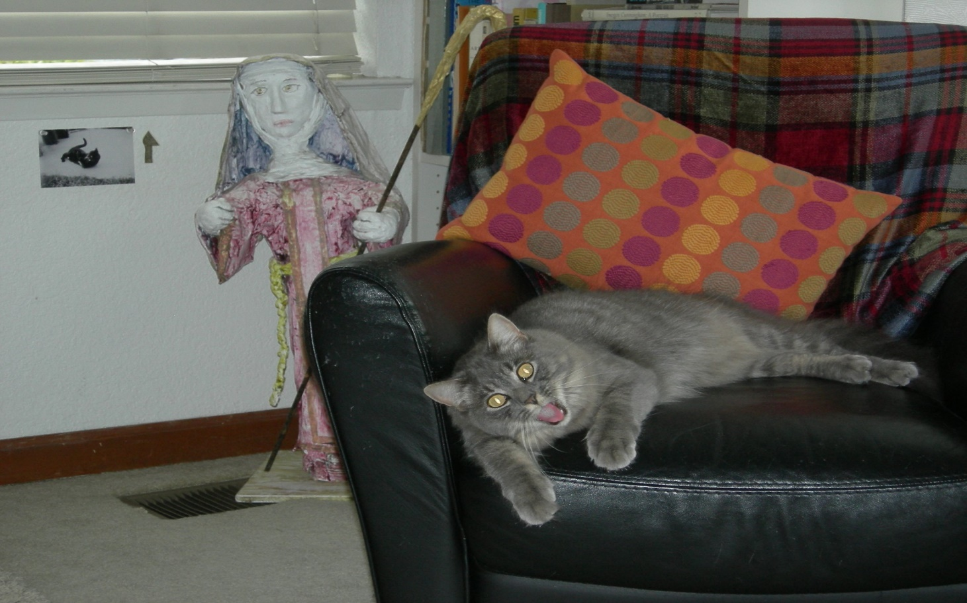
If we haven’t answered your questions today let us know. We’re just hanging around the house waiting for your call…..

